Slide 1
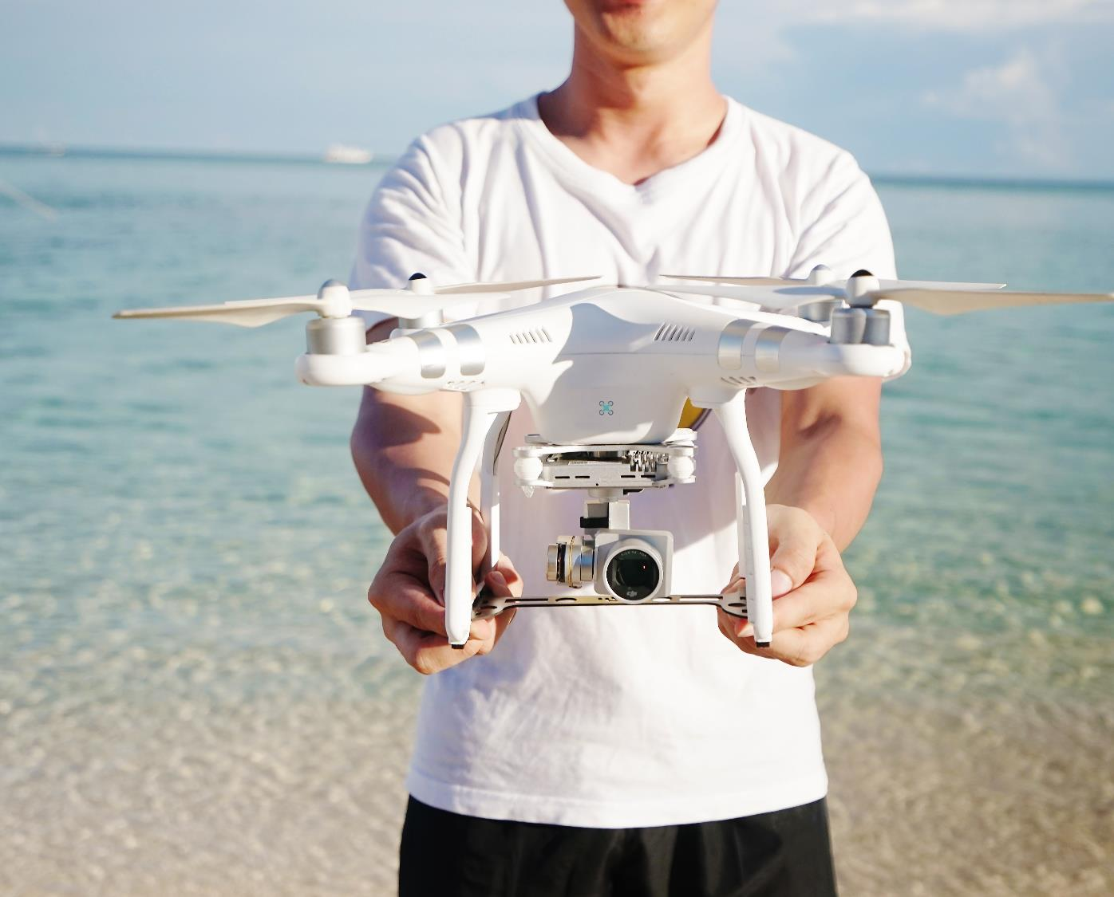

CONTOSO FALCON PRO
Customer briefings
Singapore, May 2019
@pradeepg

Slide 2
